Slide 1




For the timeperiod 2016-18
Data Analytics Project
Using SQL |
E-commerce Dataset
By Siddhant Ghosh

Slide 2




Introduction
This project is a self-initiated endeavor that utilizes skills in SQL for data analysis. The data used is sourced from public datasets (e-commerce-dataset-by-olist-as-an-sqlite-database) on Kaggle. Thank you for viewing, and I welcome any suggestions for improvement

Slide 3
The datasets provided is in two different zip files , one containing commercial transaction data, including information about customers, employees, product details, and order quantities and the other containing marketing leads and successful lead information of an e-commerce company operating in Brazil in different csv files. The entire dataset consists of 11 tables as follows:
About
The
Dataset
Customers, 2.geolocation ,3.leads_closed, 4.leads_qualified,
5.order_items, 6.order_payments, 7.order_reviews, 8.orders,
9. product_category_name_translation, 10.products,
11.sellers
After briefly reviewing our dataset, I created an ERdiagram to facilitate the querying process with SQL which is shown in the next slide. I entered the data and built the subsequent model in SQL using the pgAdmin app, which is known for managing PostgreSQL databases.

Slide 4
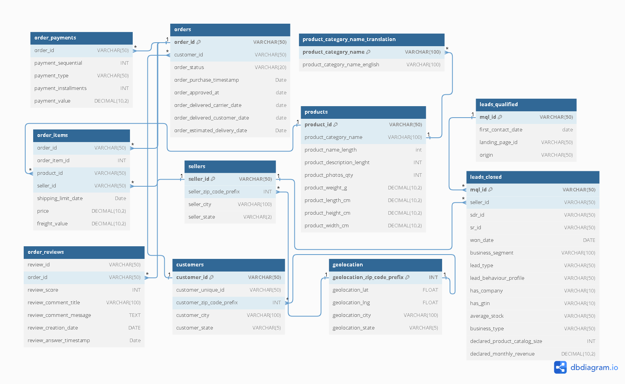

Slide 5
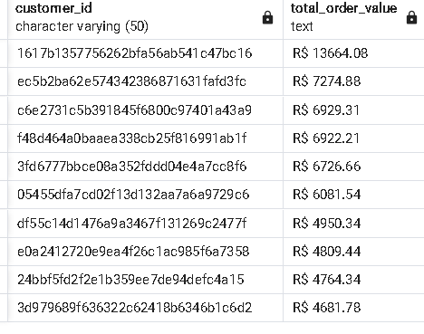

Customer Metrics
Result:
Customer Lifetime Value (CLV):-- Sum of the total order values per customer (top 5)
Customer Lifetime Value (CLV):-- Sum of the total order values per customer (top 10)
This query identifies top 10 customers of Olist
SELECT customer_id, CONCAT('R$ ', SUM(payment_value)) AS total_order_value
FROM orders JOIN
order_payments
ON orders.order_id = order_payments.order_id
GROUP BY customer_id
Order By SUM(payment_value) desc LIMIT 10;

Slide 6
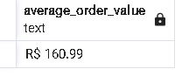
Customer Metrics
Result:
Customer Lifetime Value (CLV):-- Sum of the total order values per customer (top 5)
Average Order Value (AOV)
This query calculates the average value of an order
SELECT
CONCAT('R$ ', ROUND(SUM(payment_value) / COUNT(DISTINCT orders.order_id), 2)) AS average_order_value
FROM orders
JOIN order_payments
ON orders.order_id = order_payments.order_id;

Slide 7
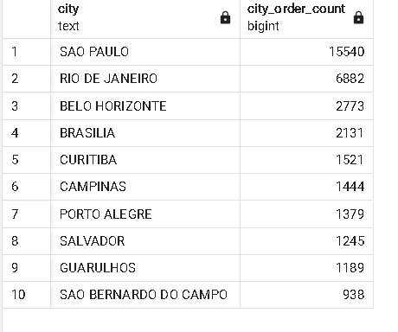
Customer Metrics
Result:
Customer Lifetime Value (CLV):-- Sum of the total order values per customer (top 5)
Customer Segmentation by Location
This query groups customers based on their location (customer_city), and shows the total order count per location.
top 10 cities by number of orders-
SELECT
UPPER(customer_city) AS city,
COUNT(orders.order_id) as city_order_count
FROM customers
JOIN orders
USING (customer_id)
GROUP BY customer_city
ORDER BY city_order_count DESC LIMIT 10;

Slide 8
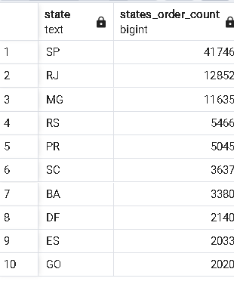
Customer Metrics
Result:
Customer Lifetime Value (CLV):-- Sum of the total order values per customer (top 5)
Customer Segmentation by Location
This query groups customers based on their location (customer_state), and shows the total order count per location.
top 10 states by number of orders-
SELECT
UPPER(customer_state) AS state,
COUNT(orders.order_id) as city_order_count FROM
customers JOIN
orders
USING (customer_id)
GROUP BY customer_state
ORDER BY city_order_count DESC LIMIT 10;

Slide 9


Top Customer (by spending)
Customer Insights
Identified top customers on the platform and surprisingly they all have spent more than R$ 4000 reaching upto R$13000
Average Customer Spending
Average customer spending on th platform is
R$ 161 which is pretty descent. Still Olist can make efforts increase this as much they can.
Customer segmentation regionally
Sao Paulo is the top city and region in customer spending followed by Rio de Generio and Bello Horizonte among cities and Rio de Generio and
Minas Gerais among states.

Slide 10
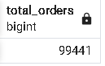
Order
Metrics
Result:
Customer Lifetime Value (CLV):-- Sum of the total order values per customer (top 5)
Total Orders
This query calculates total number of orders placed using
Olist -
SELECT
COUNT(order_id) AS total_orders
FROM orders;

Slide 11
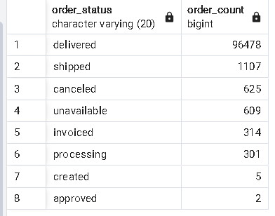
Order
Metrics
Result:
Customer Lifetime Value (CLV):-- Sum of the total order values per customer (top 5)
Order Status Breakdown
This query returns the distribution of orders based on their status (e.g., delivered, pending, canceled)-
SELECT
order_status, COUNT(order_id) AS order_count
FROM orders
GROUP BY order_status
ORDER BY order_count DESC;

Slide 12
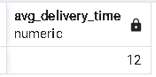
Order
Metrics
Result:
Customer Lifetime Value (CLV):-- Sum of the total order values per customer (top 5)
Order Delivery Time
This query calculates the average time between the order placement and delivery to the customer (in days)
SELECT
Round(AVG(order_delivered_customer_date - order_purchase_timestamp),0) AS avg_delivery_time
FROM orders
WHERE order_delivered_customer_date IS NOT NULL;

Slide 13

Total Orders
Order
Insights
Olist have generated nearly 100k orders in three years mostly from 2017-18 . among which more than 96k orders have been delivered successfully proving the delivery efficiency of the platform.
Average Delivery time
Average delivery time on the platform is around 12 days which is a bit longer than it’s competiotors for sure. Olist can hire more delivery partners and make more delivery godowns to improve the delivery time.
Delivery Efficiency
Among nearly 100k orders , more than 96k orders have been delivered successfully proving the delivery efficiency of the platform.

Slide 14
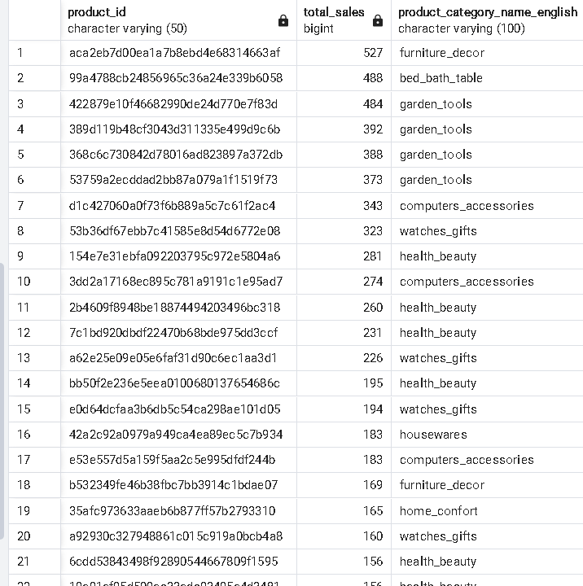
Product
Metrics
Result:
Customer Lifetime Value (CLV):-- Sum of the total order values per customer (top 5)
Top-Selling Products
This query returns the products with the highest number of sales, sorted in descending order.
SELECT
oi.product_id,
COUNT(oi.product_id) AS total_sales, pc.product_category_name_English
FROM order_items oi
JOIN products p ON p.product_id = oi.product_id
JOIN product_category_name_translation pc
ON pc.product_category_name = p.product_category_name
GROUP BY oi.product_id, pc.product_category_name_English
ORDER BY total_sales DESC;
*Note: Only a portion of the table is shown.

Slide 15
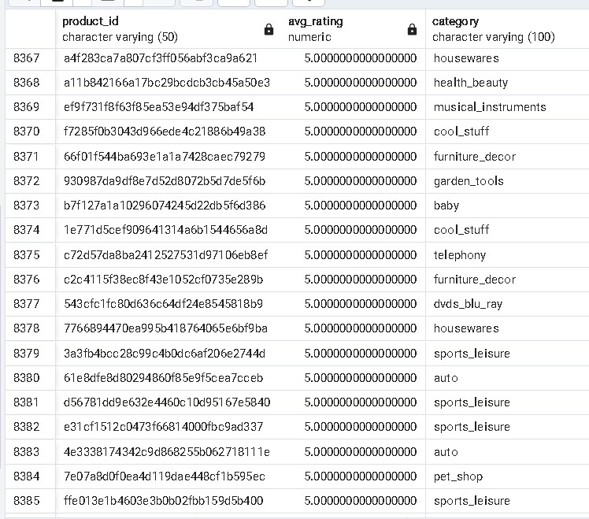
Product
Metrics
Result:
Customer Lifetime Value (CLV):-- Sum of the total order values per customer (top 5)
Average Product Rating
This query calculates the average review score for each product
SELECT
oi.product_id,
AVG(review_score) AS avg_rating,
pc.product_category_name_english AS Category
FROM
order_reviews rev
JOIN
order_items oi ON rev.order_id = oi.order_id
JOIN
products p ON p.product_id = oi.product_id
JOIN
product_category_name_translation pc ON pc.product_category_name = p.product_category_name
GROUP BY
oi.product_id, Category
ORDER BY
avg_rating DESC;
*Note: Only a portion of the table is shown.

Slide 16
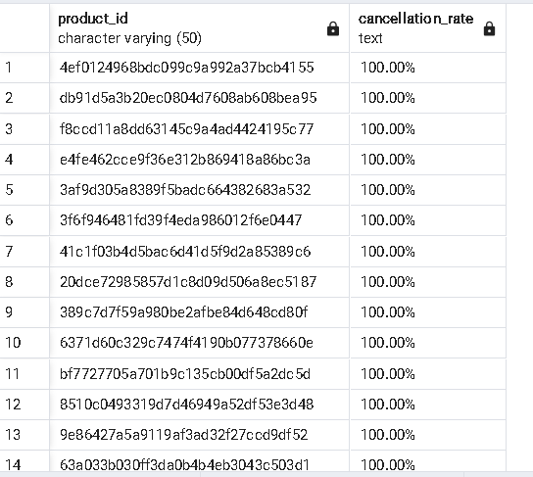
Product
Metrics
Result:
Customer Lifetime Value (CLV):-- Sum of the total order values per customer (top 5)
Product Return Rate
This query calculates the percentage of products that were returned or refunded.
WITH total_orders AS (
SELECT product_id, COUNT(order_id) AS total_orders
FROM order_items
GROUP BY product_id
),
cancelled_orders AS (
SELECT oi.product_id, COUNT(o.order_id) AS cancelled_orders
FROM order_items oi
JOIN orders o ON oi.order_id = o.order_id
WHERE order_status = 'canceled' OR order_status = 'unavailable'
GROUP BY oi.product_id
)
SELECT
t.product_id,
CONCAT(ROUND(r.cancelled_orders * 100.0 / t.total_orders, 2), '%') AS cancellation_rate
FROM
total_orders t
LEFT JOIN
cancelled_orders r ON t.product_id = r.product_id
WHERE
(r.cancelled_orders * 100.0 / t.total_orders) > 0
ORDER BY
(r.cancelled_orders * 100.0 / t.total_orders) DESC;
*Note: Only a portion of the table is shown.

Slide 17
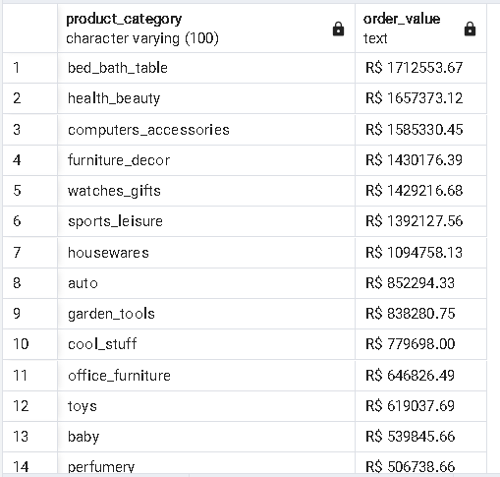
Product
Metrics
Result:
Customer Lifetime Value (CLV):-- Sum of the total order values per customer (top 5)
High Value Orders Product Category wise
This query calculates high value Orders product category wise that was ordered through Olist
SELECT
pc.product_category_name_english AS product_category,
CONCAT('R$ ', ROUND(SUM(op.payment_value), 2)) AS order_value
FROM
orders o
JOIN
customers c ON o.customer_id = c.customer_id
JOIN
order_items oi ON o.order_id = oi.order_id
JOIN
order_payments op ON o.order_id = op.order_id
JOIN
products p ON oi.product_id = p.product_id
JOIN
product_category_name_translation pc ON pc.product_category_name = p.product_category_name
GROUP BY
pc.product_category_name
HAVING
SUM(op.payment_value) > 1000
ORDER BY
SUM(op.payment_value) DESC;
*Note: Only a portion of the table is shown.

Slide 18
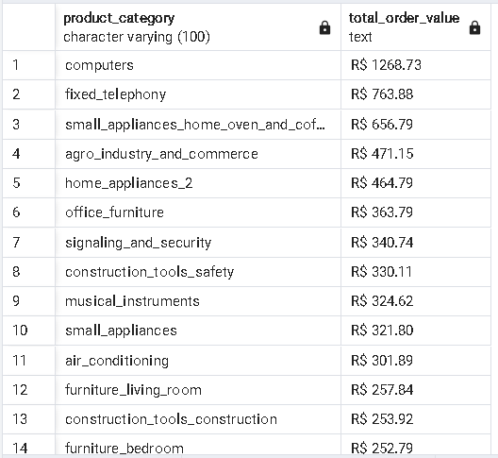
Product
Metrics
Result:
Customer Lifetime Value (CLV):-- Sum of the total order values per customer (top 5)
Expensive Products Product Category wise
This query calculates expensive orders ( >R$ 200) product category wise that was ordered through Olist
SELECT
pc.product_category_name_english AS product_category,
CONCAT('R$ ', ROUND(AVG(op.payment_value), 2)) AS total_order_value
FROM
orders o
JOIN
customers c ON o.customer_id = c.customer_id
JOIN
order_items oi ON o.order_id = oi.order_id
JOIN
order_payments op ON o.order_id = op.order_id
JOIN
products p ON oi.product_id = p.product_id
JOIN
product_category_name_translation pc ON pc.product_category_name = p.product_category_name
GROUP BY
pc.product_category_name
HAVING
AVG(op.payment_value) > 200
ORDER BY
AVG(op.payment_value) DESC;
*Note: Only a portion of the table is shown.

Slide 19

Total products metrics
Products
Insights
Successfully identified top selling products , products with top average ratings and worst products by return rate.
High value orders category wise
Identified total orders by product categories which generated highest revenues for Olist.
Bed_bath tables , health and beauty care, Computer accessories, decorative furnitures and
watches are qamong the top 5.
Expensive products listed on Olist
Succefully identified top expensive products listed on Olist. Computers top the chart.

Slide 20
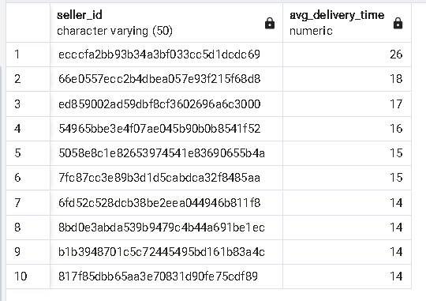
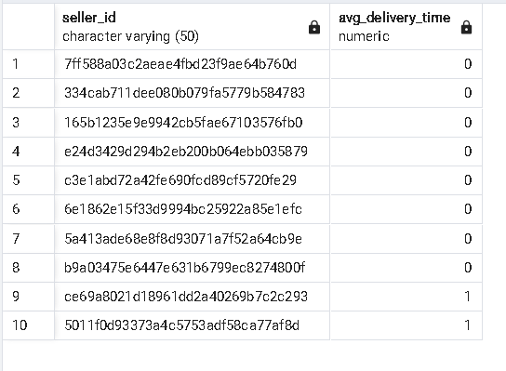
Seller
Metrics
Result:
Customer Lifetime Value (CLV):-- Sum of the total order values per customer (top 5)
Order Delivery Performance by Seller
This query calculates top 10 worst and best Sellers by delivey time existing on Olist
SELECT
seller_id,
ROUND(AVG(order_delivered_carrier_date - order_approved_at), 0) AS avg_delivery_time
FROM
order_items oi
JOIN
orders o ON oi.order_id = o.order_id
WHERE
order_delivered_carrier_date IS NOT NULL
GROUP BY
seller_id
HAVING
COUNT(o.order_id) > 10
ORDER BY
avg_delivery_time DESC
LIMIT 10;
SELECT
seller_id,
ROUND(AVG(order_delivered_carrier_date - order_approved_at), 0) AS avg_delivery_time
FROM
order_items oi
JOIN
orders o ON oi.order_id = o.order_id
WHERE
order_delivered_carrier_date IS NOT NULL
GROUP BY
seller_id
HAVING
COUNT(o.order_id) > 10
ORDER BY
avg_delivery_time ASC
LIMIT 10;
*Note: Only a portion of the table is shown.

Slide 21
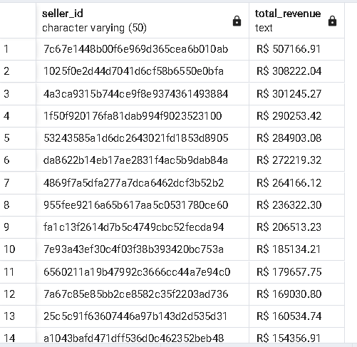
Seller
Metrics
Result:
Customer Lifetime Value (CLV):-- Sum of the total order values per customer (top 5)
Top Sellers by Revenue Generation
This query calculates top Sellers by revenue eneration
existing on Olist
SELECT
seller_id,
CONCAT('R$ ', ROUND(SUM(payment_value), 2)) AS total_revenue
FROM
order_items oi
JOIN
order_payments op ON oi.order_id = op.order_id
GROUP BY
seller_id
ORDER BY
SUM(payment_value) DESC;
*Note: Only a portion of the table is shown.

Slide 22

Top Sellers by delivery time
Seller
Insights
Successfully identified top sellers by avg delivery time and also the worst sellers by delivery time.
Top Sellers by revenue generation
Successfully identified top sellers by revenue generation for Olist. Top seller has generated more than R$500k in sales revenue.

Slide 23
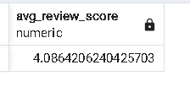
Review
Metrics
Result:
Customer Lifetime Value (CLV):-- Sum of the total order values per customer (top 5)
Average Review
This query calculates average review of the reviews given
SELECT
AVG(review_score) AS avg_review_score
FROM order_reviews;

Slide 24
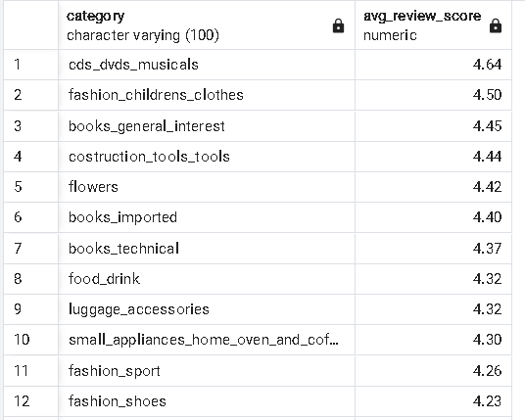
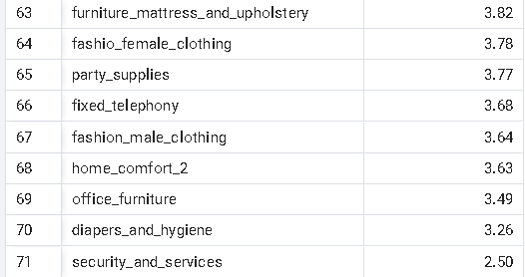
Review
Metrics
Result:
Customer Lifetime Value (CLV):-- Sum of the total order values per customer (top 5)
Average Review Category wise
This query calculates average review given
product category wise
SELECT p.category_name_english AS Category,
AVG(review_score) AS avg_review_score
FROM order_reviews o
JOIN order_items oi ON o.order_id=oi.order_id
JOIN ProductWithCategoryEnglish p ON p.product_id = oi.product_id
Group BY p.category_name_English
Order by AVG(review_score) DESC;
……
*Note: Only a portion of the table is shown.

Slide 25
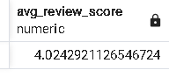
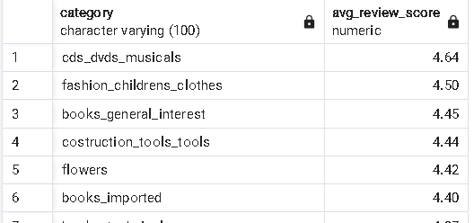
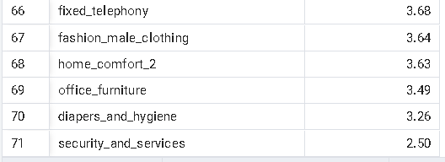
Review
Metrics
Result:
Customer Lifetime Value (CLV):-- Sum of the total order values per customer (top 5)
Average Review for high value orders
This query calculates average review given for high value orders once for all the order and again for different categories
product category wise
SELECT
AVG(r.review_score) AS avg_review_score FROM orders o
JOIN order_items oi ON o.order_id = oi.order_id
JOIN products p ON oi.product_id = p.product_id
JOIN product_category_name_translation pc ON p.product_category_name = pc.product_category_name
JOIN order_reviews r ON o.order_id = r.order_id
WHERE
oi.price > 200
ORDER BY
avg_review_score DESC;
SELECT p.category_name_english AS Category, ROUND(AVG(review_score), 2) AS avg_review_score
FROM order_reviews o JOIN order_items oi ON o.order_id = oi.order_id
JOIN ProductWithCategoryEnglish p ON p.product_id = oi.product_id
GROUP BY p.category_name_english
ORDER BY AVG(review_score) DESC;
……
*Note: Only a portion of the table is shown.

Slide 26

Average Review Score
Review
Insights
Average reviews on the platform is slightly more than 4 which is good. Olist can make some effort to increase the average review on the platform.
Reviews for different categories
Fashion clothes, books, small home applainces, food items , shoes etc have high average review which has great market potential. On the down side , male clothing , mattress , office furnitures etc has significantly low average review. These are some great segments to generate revenue.
Reviews for High value orders
The platform has just above 4 as average review for high value orders which is alarming as big e commerce website try to keep atleast 4.2t o 4.5 for their high value orders average review. Particulary the segment of office furnitures is performing poorly considering it’s potential and m,arket size. Olist has to make some serious effort in this area.

Slide 27
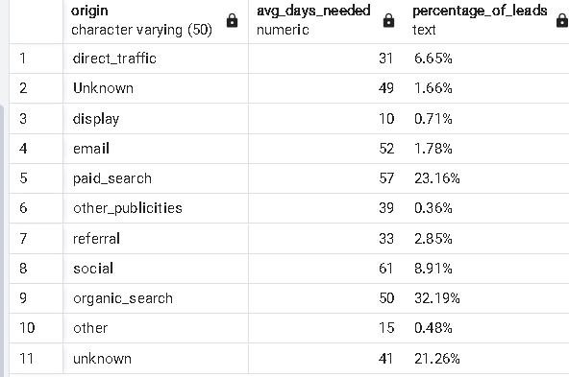
Marketing
Metrics
Result:
Customer Lifetime Value (CLV):-- Sum of the total order values per customer (top 5)
Average days needed to convert a lead into a successful one & percentage of different kind of leads
This query calculates average days needed to convert a lead and subsequently the percentage share of total lead generation (irrespective of success) category wise
SELECT
origin,
ROUND(AVG(won_date - first_contact_date), 0) AS AVG_days_needed,
CONCAT(ROUND((COUNT(mql_id) * 100.0 / SUM(COUNT(mql_id)) OVER ()), 2), '%') AS percentage_of_leads
FROM
Marketing
GROUP BY
origin;

Slide 28
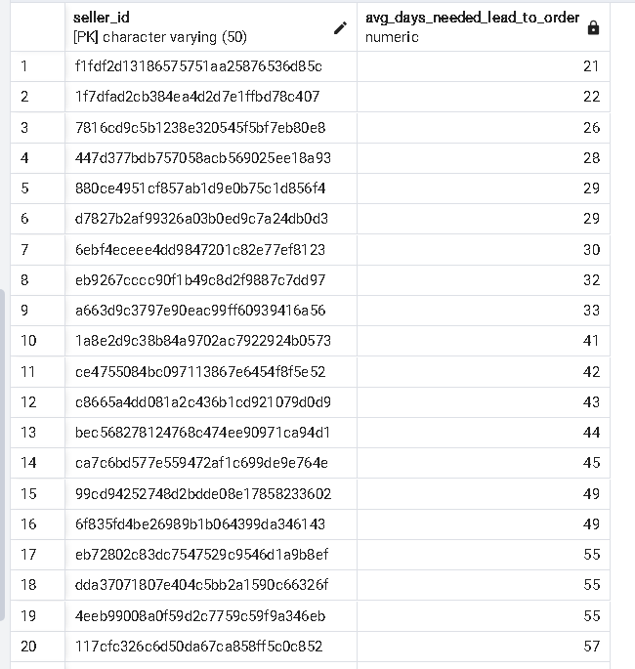
Marketing
Metrics
Result:
Customer Lifetime Value (CLV):-- Sum of the total order values per customer (top 5)
Lead-to-Order-Delivery Conversion Time For different Sellers
This query calculates average days needed to convert a lead into a successful one and making the delivery seller wise wise
SELECT
s.seller_id,
ROUND(AVG(o.order_delivered_customer_date - m.first_contact_date), 0) AS AVG_days_needed_lead_to_order
FROM
Marketing m
JOIN
sellers s ON m.seller_id = s.seller_id
JOIN
order_items oi ON oi.seller_id = s.seller_id
JOIN
orders o ON o.order_id = oi.order_id
GROUP BY
s.seller_id
HAVING
AVG(o.order_delivered_customer_date - m.first_contact_date) IS NOT NULL
IS NOT NULL ORDER BY AVG_days_needed_lead_to_order;
*Note: Only a portion of the table is shown.

Slide 29
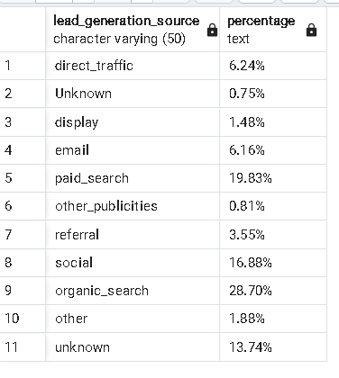
Marketing
Metrics
Result:
Customer Lifetime Value (CLV):-- Sum of the total order values per customer (top 5)
Lead-to-Order-Delivery Conversion Time For different Sellers
This query calculates the percentage share of different methods in generating 'successful' leads.
SELECT
origin AS lead_generation_source,
CONCAT(ROUND((COUNT(landing_page_id) * 100.0 / SUM(COUNT(landing_page_id)) OVER ()), 2), '%') AS percentage
FROM
leads_qualified lc
GROUP BY
origin;
*Note: Only a portion of the table is shown.

Slide 30
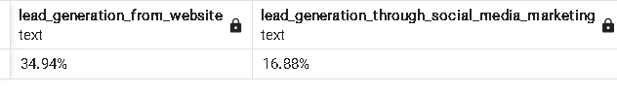
Marketing
Metrics
Result:
Customer Lifetime Value (CLV):-- Sum of the total order values per customer (top 5)
Comparison between Website and Social Media Marketing Effectiveness
This query compares between the values of percentage share of lead generating traffic in through the company website (organic) and social media (advertisement)
WITH total_leads AS (
SELECT
SUM(COUNT(landing_page_id)) OVER () AS total_leads
FROM
leads_qualified
)
SELECT
CONCAT(ROUND(
(COUNT(CASE WHEN origin IN ('direct_traffic', 'organic_search') THEN landing_page_id END) * 100.0)
/ (SELECT total_leads FROM total_leads), 2), '%') AS lead_generation_from_website,
CONCAT(ROUND(
(COUNT(CASE WHEN origin IN ('social') THEN landing_page_id END) * 100.0)
/ (SELECT total_leads FROM total_leads), 2), '%') AS lead_generation_through_social_media_marketing
FROM
leads_qualified;

Slide 31

Lead Convertion to order
Marketing Insights
Lowest days needed for lead conversion is already as low as three weeks. Olist can try to achieve atleast two weeks as lowest.
Website vs Social Media Marketing
Website’s organic traffic beats social media marketing lead generation which indicates that the brand name is getting stronger and established in the sector so that customers are trying to find us more
Effectiveness of Social media ads
Social media ads generates only 8.91% leads but it generates 16.88% of successful leads which indicates Olist’s efficient social media campaigning. Olist now need to campaign a bit more aggresively

Slide 32
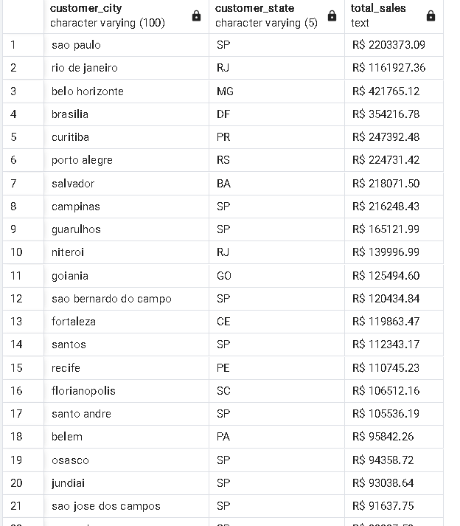
Regional
Metrics
Result:
Customer Lifetime Value (CLV):-- Sum of the total order values per customer (top 5)
Sales by Region (Customer Location)
This query calculates total sales grouped by customer city and state.
SELECT
customer_city,
customer_state,
CONCAT('R$ ', ROUND(SUM(payment_value), 2)) AS total_sales
FROM
orders o
JOIN
order_payments op ON o.order_id = op.order_id
JOIN
customers c ON o.customer_id = c.customer_id
GROUP BY
customer_city, customer_state
ORDER BY
SUM(payment_value) DESC;
*Note: Only a portion of the table is shown.

Slide 33
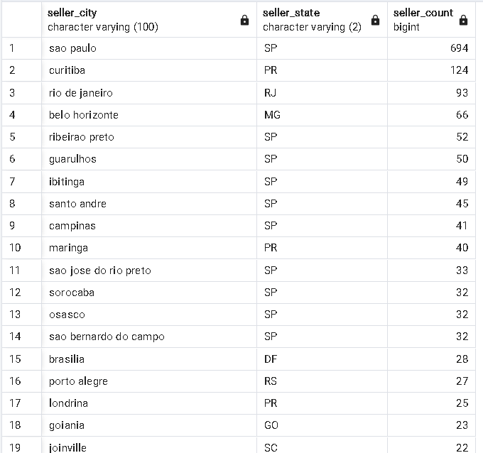
Regional
Metrics
Result:
Customer Lifetime Value (CLV):-- Sum of the total order values per customer (top 5)
Seller Concentration by Region
This query calculates the number of sellers in each city and state
SELECT
seller_city,
seller_state,
COUNT(seller_id) AS seller_count
FROM
sellers
WHERE seller_state <> 'NA'
GROUP BY
seller_city, seller_state
ORDER BY
seller_count DESC;
*Note: Only a portion of the table is shown.

Slide 34
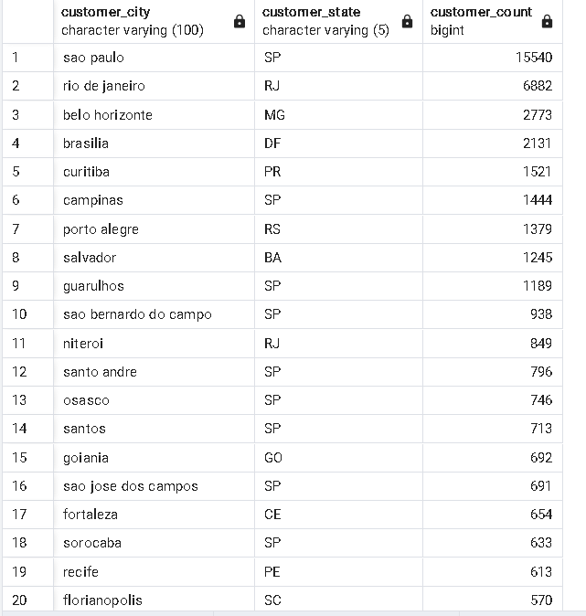
Regional
Metrics
Result:
Customer Lifetime Value (CLV):-- Sum of the total order values per customer (top 5)
Customer Concentration by Region
This query calculates the number of customers in each city and state
SELECT
customer_city,
customer_state,
COUNT( customer_id) AS customer_count
FROM customers
WHERE customer_state <> 'NA’
GROUP BY customer_city, customer_state
ORDER BY customer_count DESC;
*Note: Only a portion of the table is shown.

Slide 35
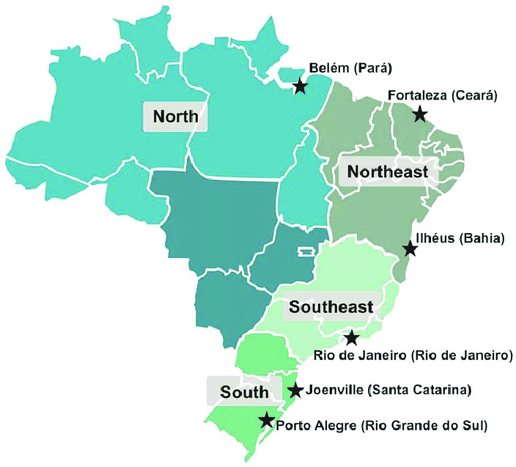
Sales by Region
Regional
Insights
Successfully identified regions which has highest sales. Unsuprisingly , Sao Paulo , Rio and Bello Horizonte has the higest number of sales.
Customer Concentration
Successfully identified regions which has highest customer concentration. Unsuprisingly , Sao Paulo , Rio and Bello Horizonte has the higest number of customer concentration.
Seller Concentration
Successfully identified regions which has highest seller concentration. Sao Paulo , Curitiba and Rio has the higest number of customer concentration.

Slide 36
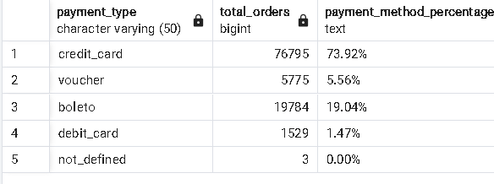
Payment
Metrics
Result:
Customer Lifetime Value (CLV):-- Sum of the total order values per customer (top 5)
Payment Method Distribution
This query calculates percentage of orders paid via different payment methods (e.g., credit card, PayPal)
SELECT
payment_type,
COUNT(*) AS total_orders,
CONCAT(ROUND((COUNT(*) * 100.0 / (SELECT COUNT(*) FROM order_payments)), 2), '%') AS payment_method_percentage
FROM
order_payments
GROUP BY
payment_type
ORDER BY
payment_method_percentage DESC;

Slide 37
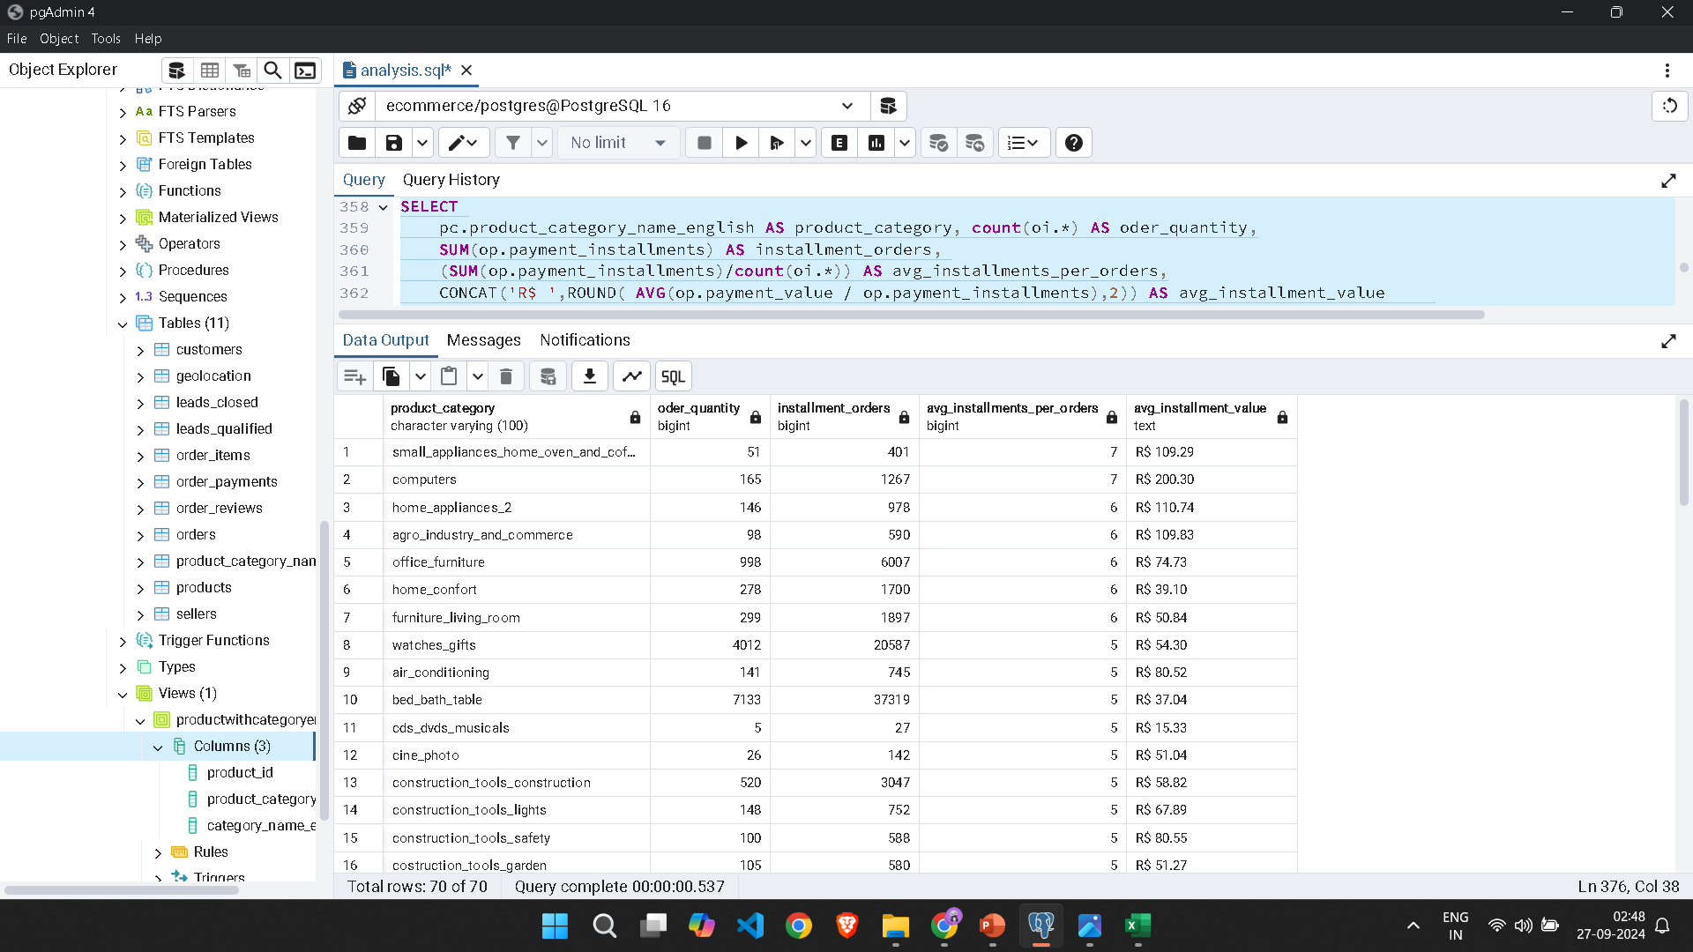
Payment
Metrics
Result:
Customer Lifetime Value (CLV):-- Sum of the total order values per customer (top 5)
Installment Plans Usage
This query calculates number of orders using installment payments
SELECT
pc.product_category_name_english AS product_category,
COUNT(oi.*) AS order_quantity,
SUM(op.payment_installments) AS installment_orders,
(SUM(op.payment_installments) / COUNT(oi.*)) AS avg_installments_per_order,
CONCAT('R$ ', ROUND(AVG(op.payment_value / op.payment_installments), 2)) AS avg_installment_value
FROM
order_payments op
JOIN
order_items oi ON op.order_id = oi.order_id
JOIN
products p ON oi.product_id = p.product_id
JOIN
product_category_name_translation pc ON p.product_category_name = pc.product_category_name
WHERE
op.payment_installments > 1
GROUP BY
pc.product_category_name_english
ORDER BY
avg_installments_per_order DESC;
*Note: Only a portion of the table is shown.

Slide 38

Payment Method Distribution
Most of the payments , approx. 74% of the payments have been done using a credit card .
Olist must collaborate with different credit card companies to give as many as offers and discounts they can give to increase the salses.
Payment Insights
Availability of EMIs
Various home appliances and Computers has more number of average EMIs which are high in value too. Olist must focus to increase the availibilty and the ease of the process to increase sales in these areas.
Making the payment system efficient
Olist have done a tremendous job on creating an efficient online payment system as the pay on delivery method is almost neglible . Olist must keep it up such a good efficient system

Slide 39
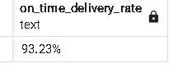
Shipping
Metrics
Result:
Customer Lifetime Value (CLV):-- Sum of the total order values per customer (top 5)
On-time Delivery Rate
This query calculates on-time Delivery Rate (i.e., the percentage of orders delivered before the estimated delivery date)
SELECT
CONCAT(ROUND((COUNT(CASE WHEN order_delivered_customer_date <= order_estimated_delivery_date
THEN 1 END) * 100.0 / COUNT(order_id)), 2), '%') AS on_time_delivery_rate
FROM
orders
WHERE
order_delivered_customer_date IS NOT NULL
AND order_estimated_delivery_date IS NOT NULL;

Slide 40
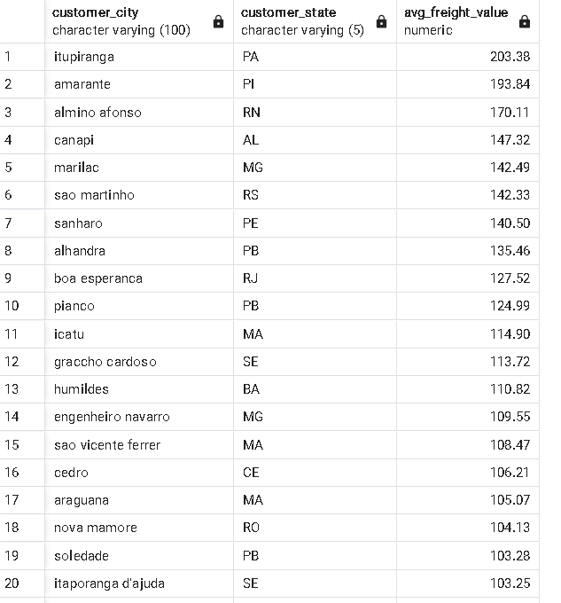
Shipping
Metrics
Result:
Customer Lifetime Value (CLV):-- Sum of the total order values per customer (top 5)
Average delivery cost region-wise
This query calculates average delivery cost region-wise
SELECT
c.customer_city,
c.customer_state,
ROUND(AVG(oi.freight_value), 2) AS avg_freight_value
FROM
orders o
JOIN
customers c ON o.customer_id = c.customer_id
JOIN
order_items oi ON o.order_id = oi.order_id
GROUP BY
c.customer_city, c.customer_state
ORDER BY
avg_freight_value DESC;
*Note: Only a portion of the table is shown.

Slide 41

On time Delivery
Shipping
Insights
Olist completes 93.23% delivery on time which
Indicates their determination for timely deliveries.
Delivery costs for different regions
Identified delivery costs for different regions. Itupiranga tops the chart with more than R$200 average delivery cost which surprisingly high. Olist can make delivery godowns in this place where delivery cost is unusually high.

Slide 42
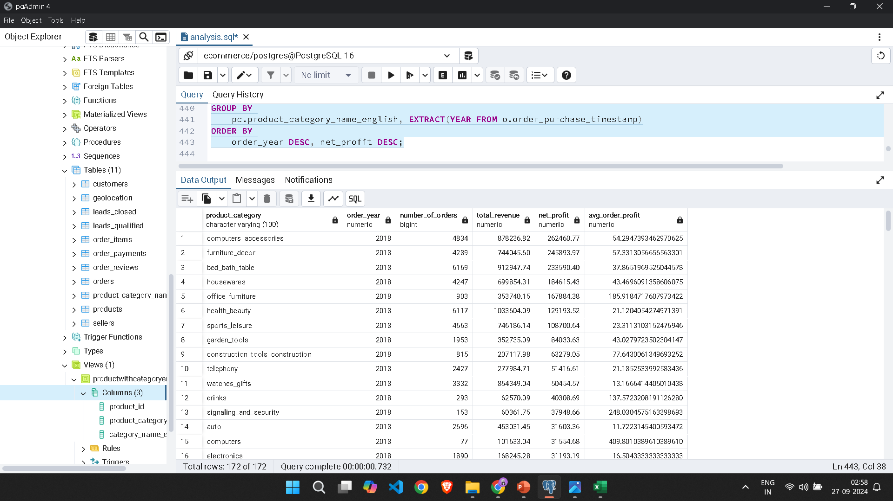
Growth
Metrics
Result:
Customer Lifetime Value (CLV):-- Sum of the total order values per customer (top 5)
Revenue, Net Profit , Average Order Profit year on year category wise
This query calculates Revenue, Net Profit , Average Order Profit year on year category wise
SELECT
pc.product_category_name_english AS product_category,
EXTRACT(YEAR FROM o.order_purchase_timestamp) AS order_year,
COUNT(op.order_id) AS number_of_orders,
SUM(op.payment_value) AS total_revenue,
SUM(op.payment_value - (oi.price + oi.freight_value)) AS net_profit,
AVG(op.payment_value - (oi.price + oi.freight_value)) AS avg_order_profit
FROM
products p
JOIN
product_category_name_translation pc ON pc.product_category_name = p.product_category_name
JOIN
order_items oi ON p.product_id = oi.product_id
JOIN
order_payments op ON oi.order_id = op.order_id
JOIN
orders o ON oi.order_id = o.order_id
GROUP BY
pc.product_category_name_english, EXTRACT(YEAR FROM o.order_purchase_timestamp)
ORDER BY
order_year DESC, net_profit DESC;
*Note: Only a portion of the table is shown.

Slide 43
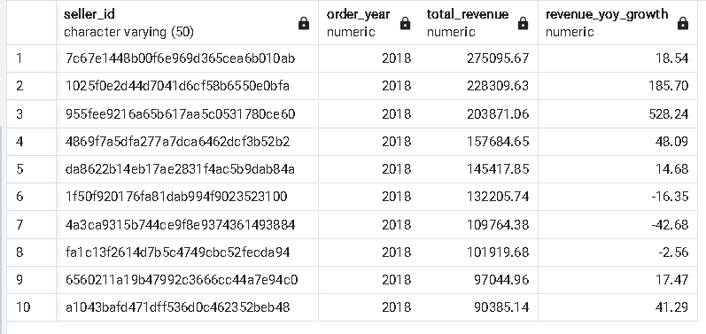
Growth
Metrics
Result:
Customer Lifetime Value (CLV):-- Sum of the total order values per customer (top 5)
Top 10 sellers of 2018
This query calculates top 10 sellers of 2018
WITH yearly_seller_stats AS ( SELECT oi.seller_id,
EXTRACT(YEAR FROM o.order_purchase_timestamp) AS order_year, SUM(op.payment_value) AS total_revenue
FROM order_items oi
JOIN orders o ON oi.order_id = o.order_id
JOIN order_payments op ON oi.order_id = op.order_id
GROUP BY oi.seller_id, EXTRACT(YEAR FROM o.order_purchase_timestamp)
), seller_growth AS (
SELECT seller_id, order_year, total_revenue,
LAG(total_revenue) OVER (PARTITION BY seller_id ORDER BY order_year) AS prev_year_revenue,
ROUND(((total_revenue - LAG(total_revenue) OVER (PARTITION BY seller_id ORDER BY order_year)) /
NULLIF(LAG(total_revenue) OVER (PARTITION BY seller_id ORDER BY order_year), 0)) * 100, 2) AS revenue_yoy_growth
FROM yearly_seller_stats
) SELECT seller_id, order_year, total_revenue, revenue_yoy_growth FROM seller_growth
WHERE revenue_yoy_growth IS NOT NULL AND order_year IN (2018)
ORDER BY total_revenue DESC LIMIT 10;

Slide 44
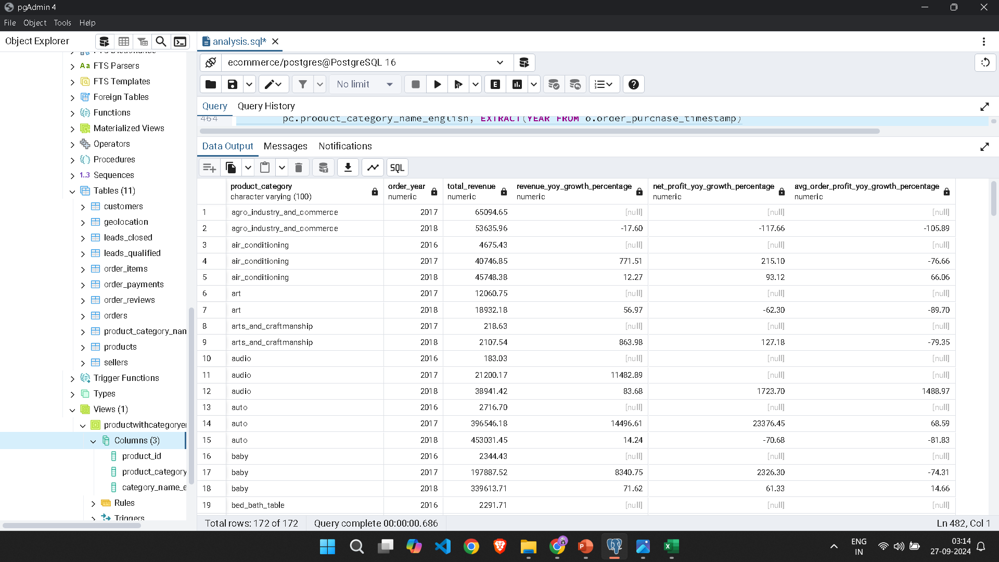
Growth
Metrics
Result:
Customer Lifetime Value (CLV):-- Sum of the total order values per customer (top 5)
Growth of Revenue, Net Profit , Average Order Profit year on year category wise
This query calculates growth of Revenue, Net Profit , Average Order Profit year on year category wise
Query is on the next tab
*Note: Only a portion of the table is shown.

Slide 45
WITH yearly_stats AS (
SELECT
pc.product_category_name_english AS product_category,
EXTRACT(YEAR FROM o.order_purchase_timestamp) AS order_year,
SUM(op.payment_value) AS total_revenue,
SUM(op.payment_value - (oi.price + oi.freight_value)) AS net_profit,
AVG(op.payment_value - (oi.price + oi.freight_value)) AS avg_order_profit
FROM
products p
JOIN
product_category_name_translation pc ON pc.product_category_name = p.product_category_name
JOIN
order_items oi ON p.product_id = oi.product_id
JOIN
order_payments op ON oi.order_id = op.order_id
JOIN
orders o ON oi.order_id = o.order_id
GROUP BY
pc.product_category_name_english, EXTRACT(YEAR FROM o.order_purchase_timestamp)
ORDER BY
order_year DESC, net_profit DESC
)
SELECT
product_category,
order_year,
total_revenue,
ROUND(((total_revenue - LAG(total_revenue) OVER (PARTITION BY product_category ORDER BY order_year)) /
NULLIF(LAG(total_revenue) OVER (PARTITION BY product_category ORDER BY order_year), 0)) * 100, 2) AS revenue_yoy_growth_percentage,
ROUND(((net_profit - LAG(net_profit) OVER (PARTITION BY product_category ORDER BY order_year)) /
NULLIF(LAG(net_profit) OVER (PARTITION BY product_category ORDER BY order_year), 0)) * 100, 2) AS net_profit_yoy_growth_percentage,
ROUND(((avg_order_profit - LAG(avg_order_profit) OVER (PARTITION BY product_category ORDER BY order_year)) /
NULLIF(LAG(avg_order_profit) OVER (PARTITION BY product_category ORDER BY order_year), 0)) * 100, 2) AS avg_order_profit_yoy_growth_percentage
FROM
yearly_stats
ORDER BY
product_category, order_year;

Slide 46

Revenue, Net profit
Identified top segments which generated most of the revenues and net profits. Computer accessories tops the chart while surprisingly despite pretty average reviews, revenue generation from office furnitures sits at no.5 indicating the the potential it this market has.
Growth
Insights
Top sellers in recent year
Identified top 10 sellers of 2018 with their yearly growth in sales. Some of them have shown growths from 100% ranging upto 500%.
YoY Growth in revenue, profits
Olist have recorded an huge surge in sales 2017 recording growth in 4 to 5 digits in some cases. However , growth in 2018 tanked to mere two digits or one digits in many categories and in some cases it went negative. For an ecommerce , it should grow exponentially in their initial years to establish the company n this sector. Olist have to make a lot of efforts to do that.

Slide 47
Recommendations to increase Business & Profit
Delivery
Marketing
Products
Threats
Increase seller network and establish more godowns to reduce average delivery time and delivery costs
Make the social media marketing more aggressive it tends to generates for successful lead generation
Focus on large markets which has huge potential yet Olist performs a bit poorly as per the average customer reviews suggests (ex- Office Furnitures)
Olist’s growth tanked in 2018 in many segments. Ecommerce company must have growth exponentially to stay in the business and establish the brand. Olist’s 2018 growth could be an alarming indication of their future

Slide 48


Thank You!
-From
Siddhant Ghosh
I’m excited to continue growing and taking on more challenges that blend analytics with business understanding! Feel free to add any suggestions or recommendations.

